Slide 1

KGiSL INSTITUTE OF TECHNOLOGY
COIMBATORE
DEPARTMENT OF computer science & engineering
MINI Project phase review # 03
INTELLIGENCE EXPEDITIOUS ACCIDENT DETECTION
Team Members:
711719104054 Nandika L R
711719104061 Nivethitha S
711719104094 Sneha C I
711719104103 Treesa Mary George
Under the guidance of :
Ms. Aruna T N , Asst. Professor,CSE.

Slide 2

agenda
Objective of the project work
Existing System
Proposed System
Expected Outcome
References
Timeline

Slide 3
abstract
Detection of human error caused in driving a 4 wheeler vehicle to prevent accidents expeditiously. The idea behind the human error in driving is to detect the drowsiness of the driver by measuring the facial emotions over real time with the help of Computer Vision and Shape Predictor Model and alert the driver immediately. An alert message is send automatically by the system to the concerned ones if the driver persists in the non-stop dozing or yawning state in order to escape the mishap.The highest advantage of this system is to reduce the chance of human error by detecting it swiftly.

Slide 4
Literature Survey
S. No | Title of the paper | Year | Author | Description
1 | A Survey Paper On Drowsiness Detection & Alarm System for Drivers | Jan-2017 | Sumedh G Dhengre | Drowsiness Detection and Alarm system for drivers
2 | Accident Prevention using OpenCV | Apr-2021 | Shoaib Rayeen | Shape Predictor Trained model
3 | Driver Drowsiness Detection System with OpenCV & Keras | May-2021 | Data Flair | Open Source Computer vision library

Slide 5
S. No | Title of the paper | Year | Author | Description
4 | Computer Vision Projects with Python | Nov-2020 | Aman Kharwal | Facial landmarks using OpenCV
5 | WakeApp System | Jan-2022 | Judit Halperin | Sending Voice mail to the concerned Emergency contact.

Slide 6
EXISTING SYSTEM
The existing system includes finding the drowsiness of the driver in real time and notify him/her of the current state.
At first, the human face is detected using Open CV and then the various poses are being captured where the closure of eyes is highly analyzed by the Shape Predictor model to find the signs of exhaustion in drivers in order to avoid a misadventure.
DRAWBACKS
If the driver continues to be in the dozy state even after the continuous ringing of alarm, then there are chances for a great disaster to take place.
If the driver wears glasses, it becomes hard to detect the closure of eyes and hence this requires to be revised again.

Slide 7
PROPOSED SYSTEM
Since a drowsy person can yawn at times, the same can be done for detecting ‘yawning’ too. If the person yawns while driving, it would prompt another alert alarm for this to make him/her caution.
After the detection, the model identifies if the driver is dozy or not by comparing with a threshold value to that of the real time. Then the system will alert the driver of the drowsiness.
ADVANTAGES
In case if the driver wears glasses while driving, detection of mouth is done to identify whether he/she is yawning which ultimately causes the alarm to ring .
To overcome the drawbacks of the driver’s non-stop dozing or yawning state we will further make an alert message to the concerned ones in order to escape the mishap.

Slide 8
architecturAL diagarm
CAMERA
ON DOZY STATE
DRIVER
ALERT
FACE DETECTION
REGION OF INTEREST
IF DRIVER STILL DOZY
EYES
MOUTH
ALERT MESSAGE TO CONCERNED ONES

Slide 9
Modules split up
Module 1 | Eye Closure Detection
Module 2 | Yawn Detection
Module 3 | Alarm Notification
Module 4 | Alert message to the concerned person

Slide 10
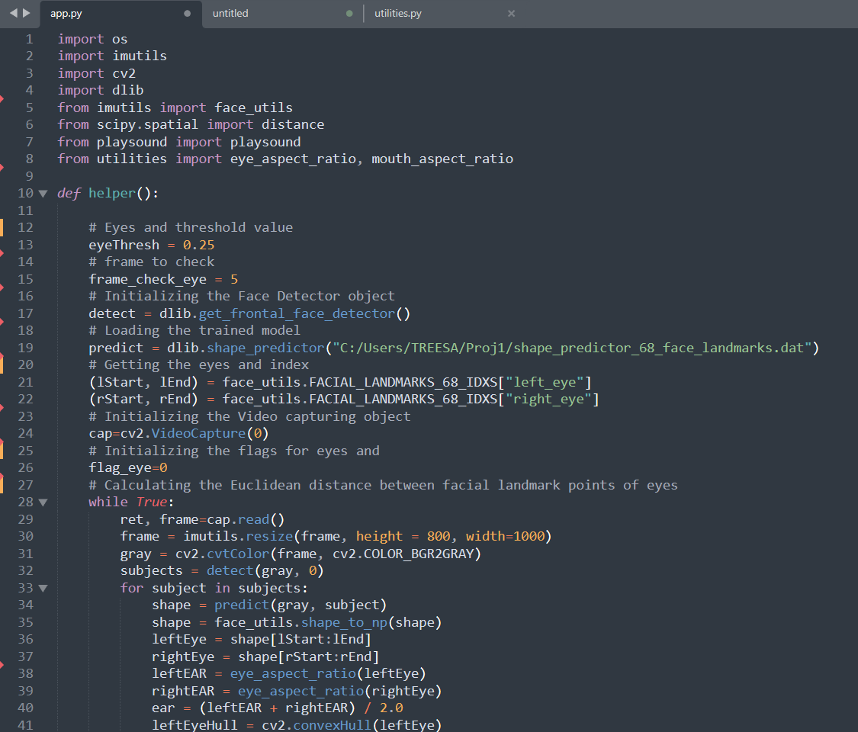
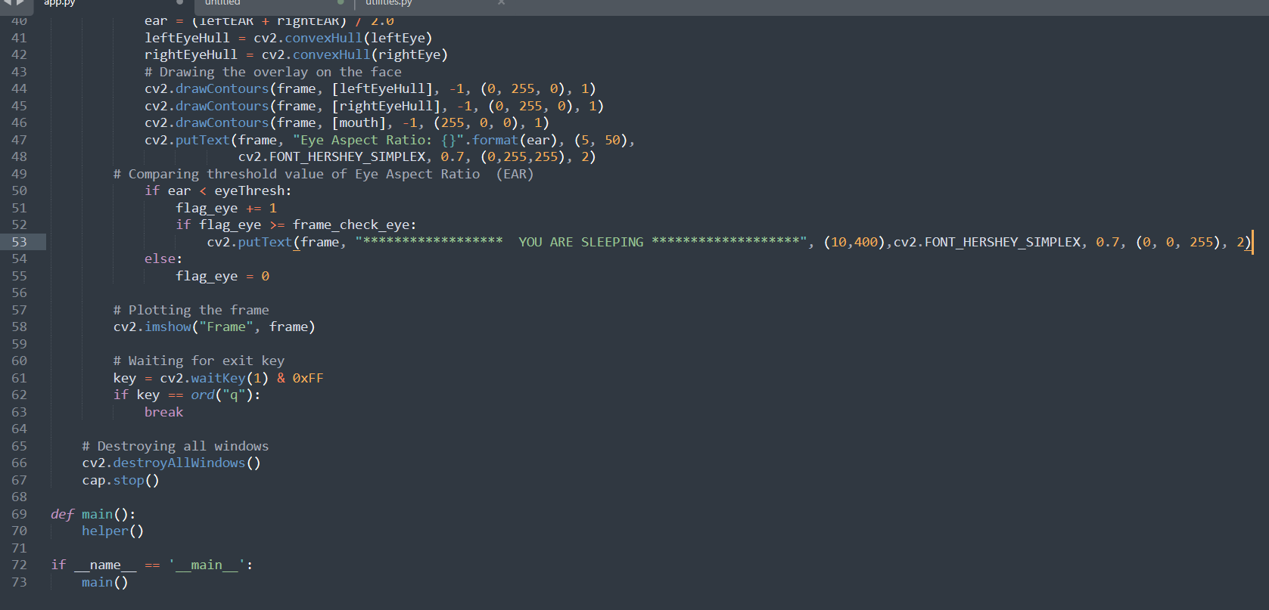
SCREENSHOTS : Module-i

Slide 11
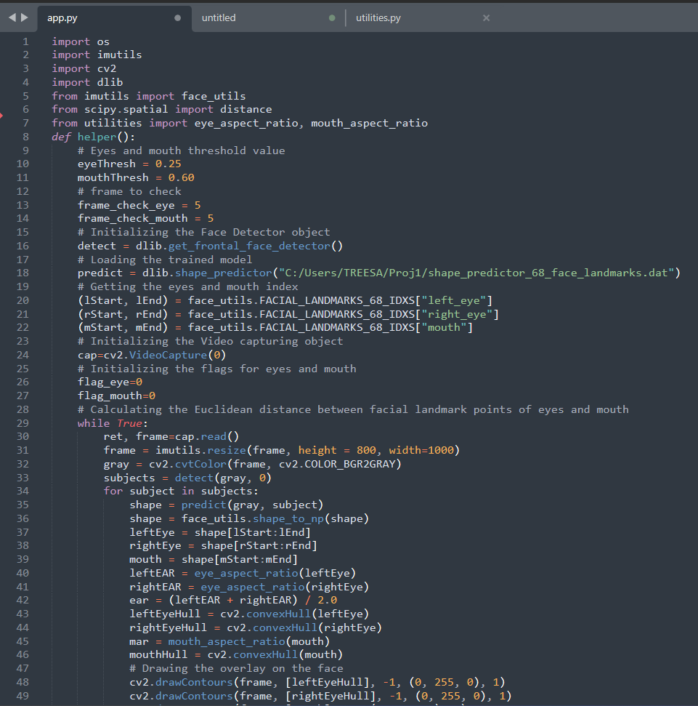
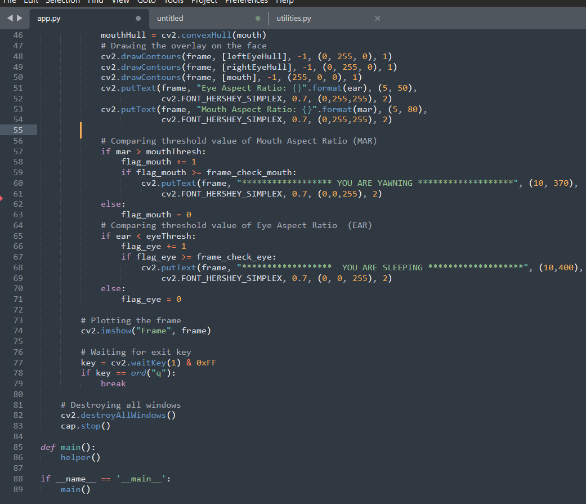
SCREENSHOTS : Module-iI

Slide 12
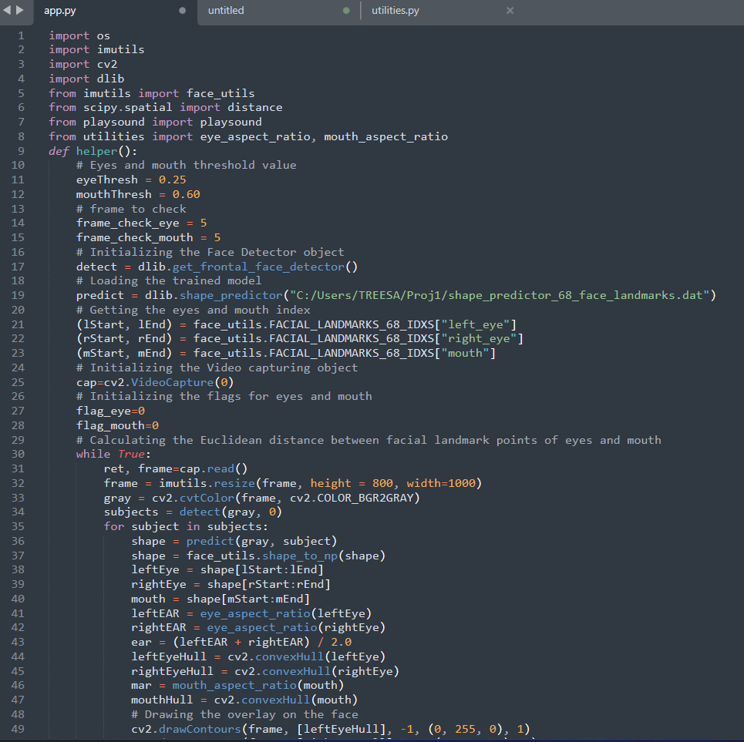
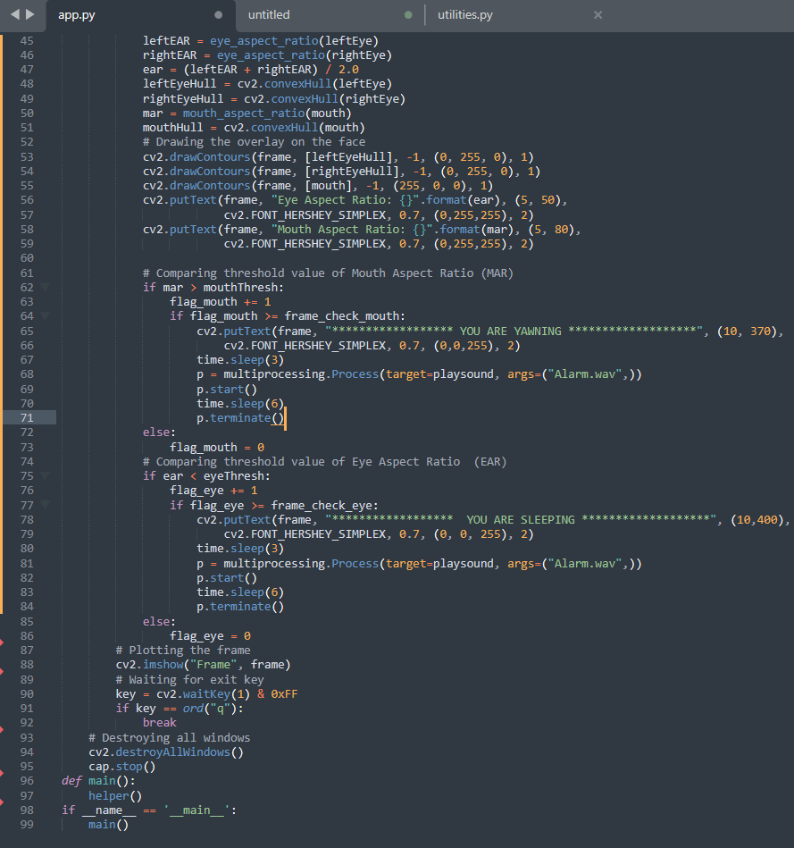
SCREENSHOTS : Module-iII

Slide 13
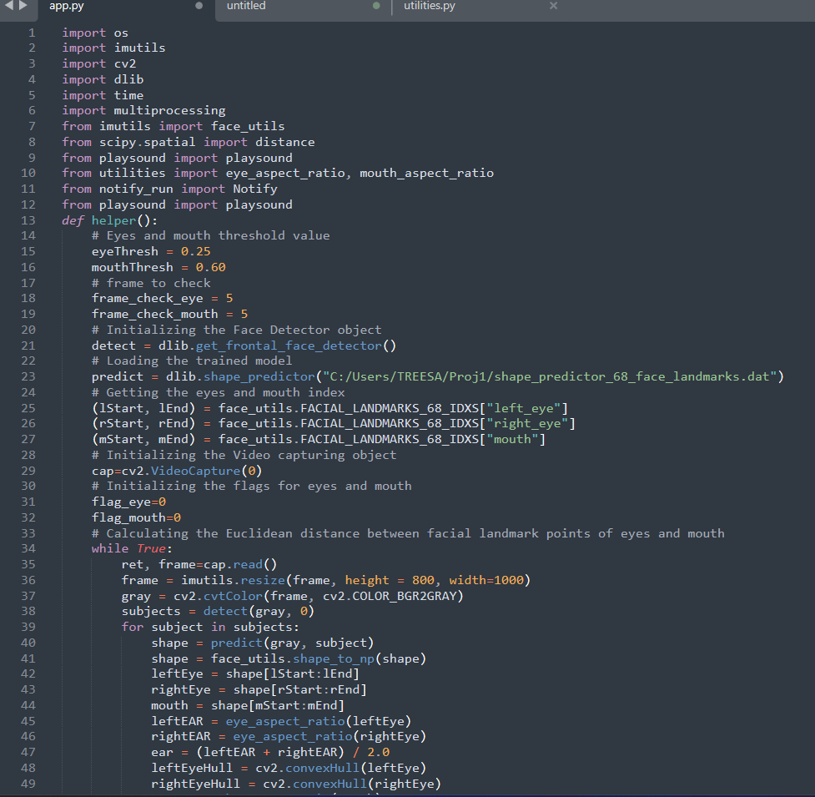
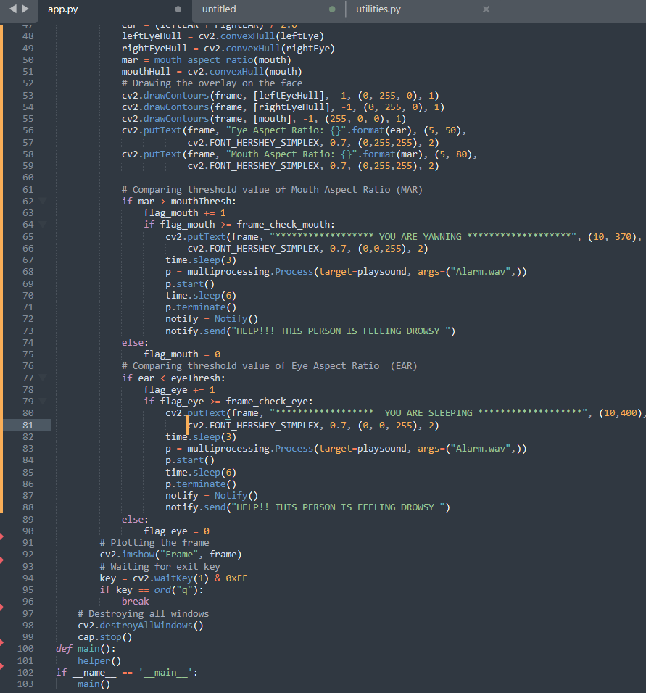
SCREENSHOTS : Module-iV

Slide 14
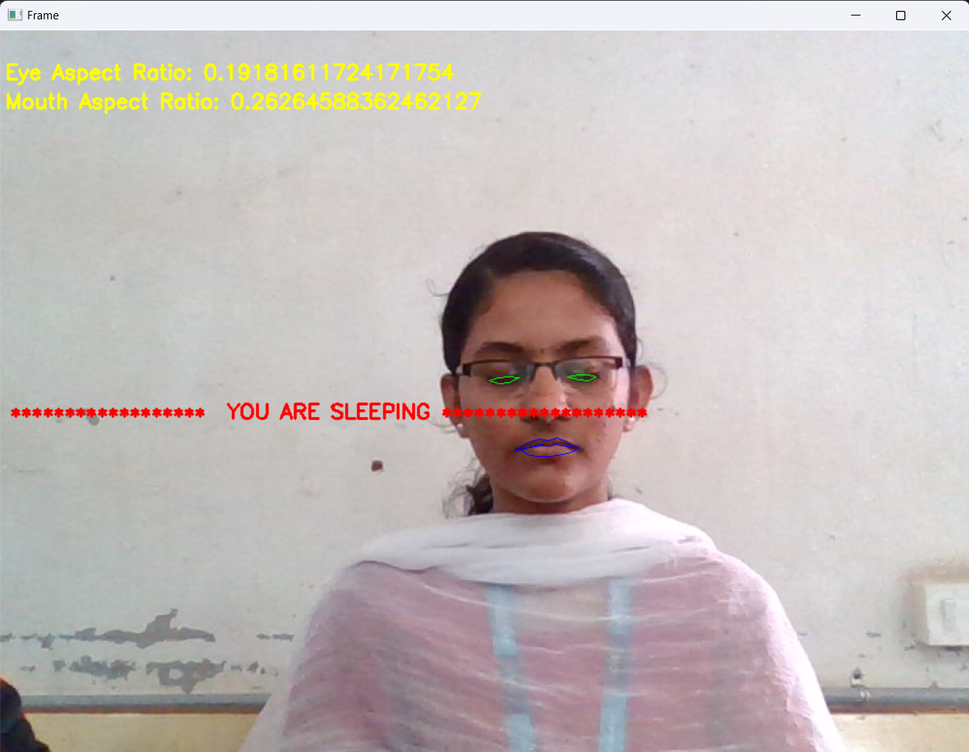
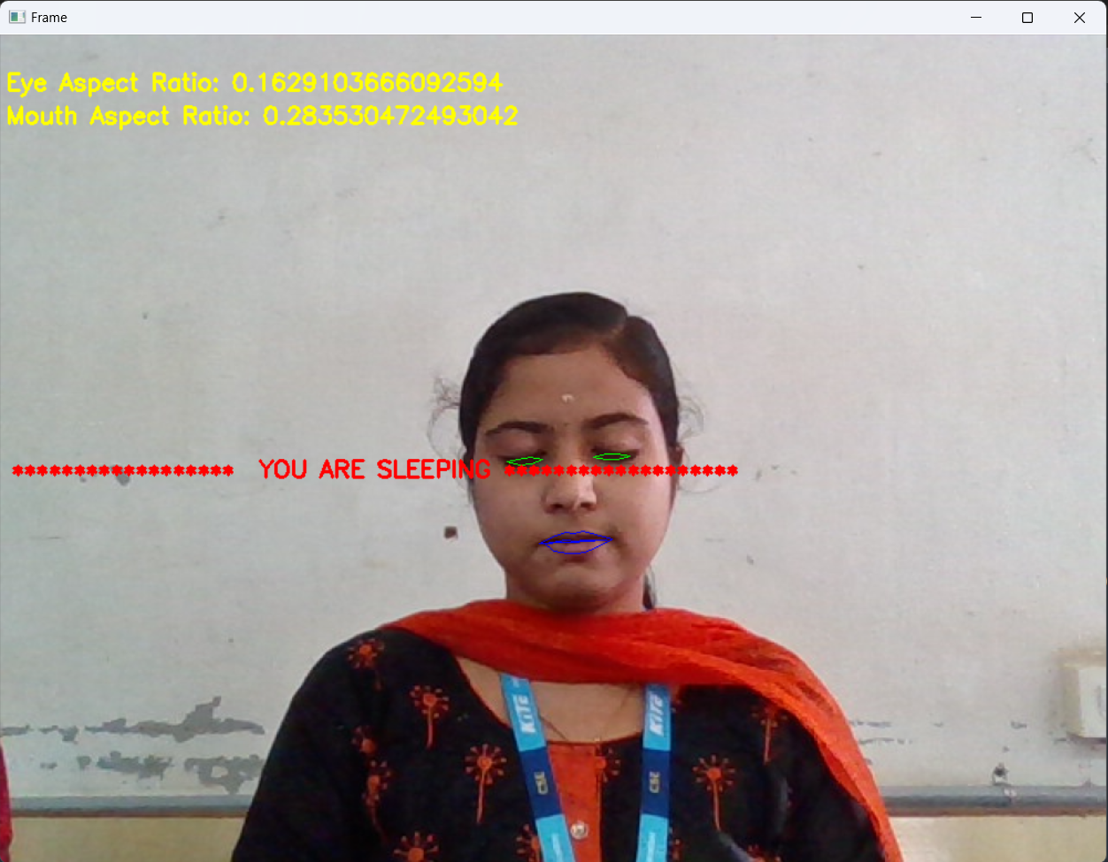
OUTPUT: MoDULE i

Slide 15
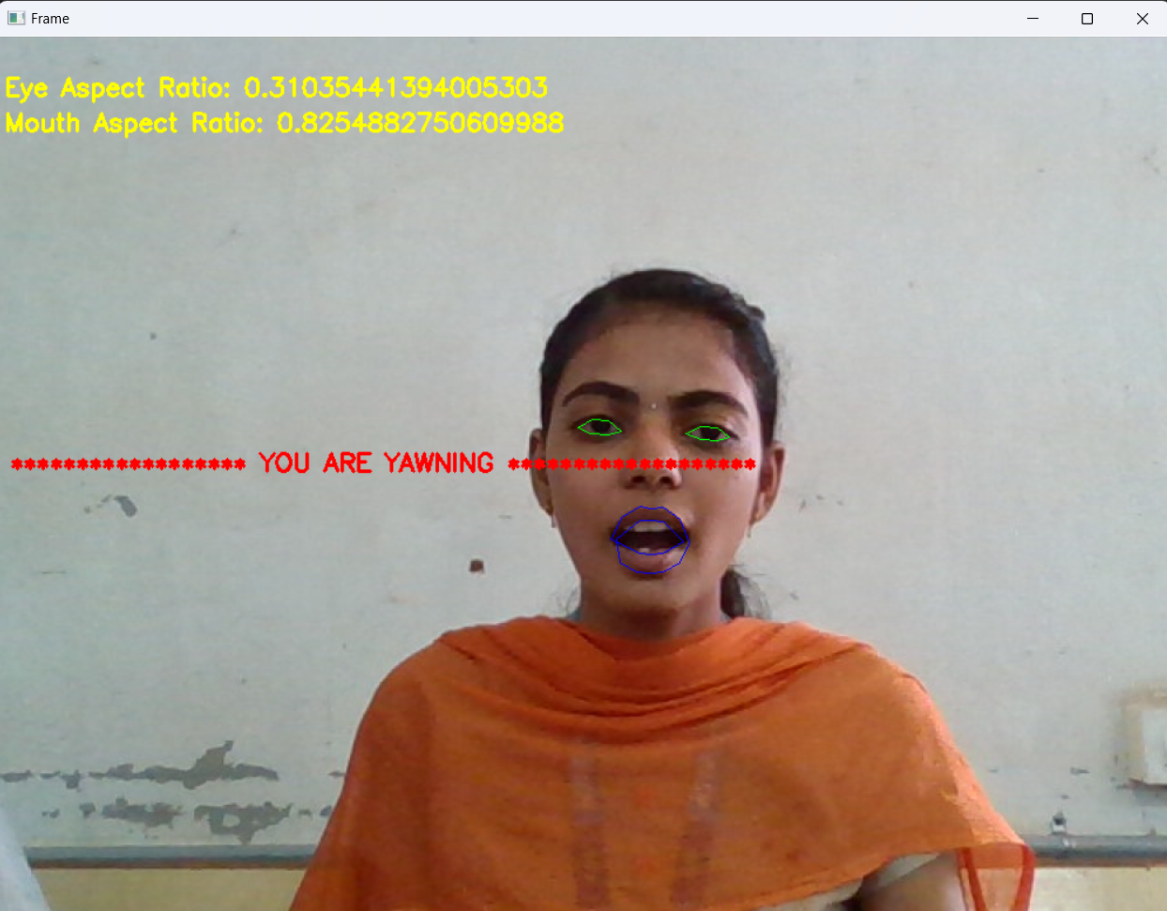
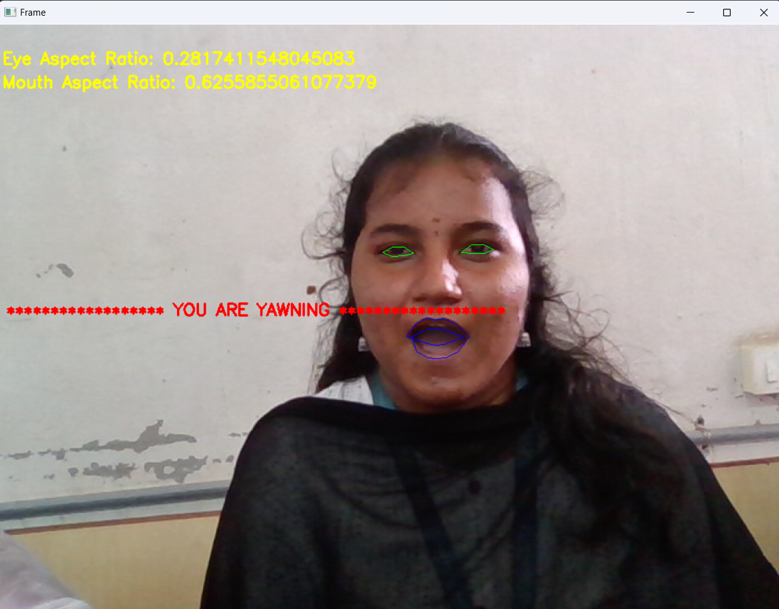
OUTPUT: MoDULE ii

Slide 16
OUTPUT: MoDULE iiI
ALARM SOUND

Slide 17
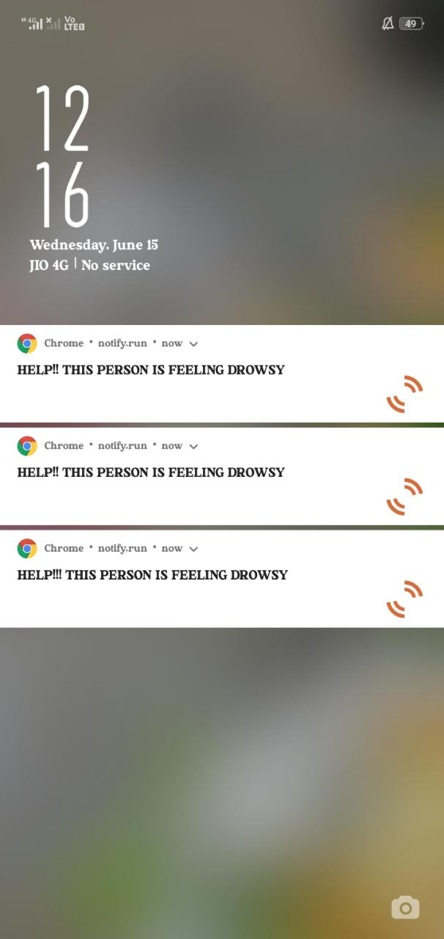
OUTPUT: MoDULE iV

Slide 18
EXPECTED OUTCOME
On detection of the various postures ,if it is identified that the driver is drowsy for a certain period of time, we will assume that the driver is starting to doze off and then we will play an alarm to wake him/her up and grab their attention as soon as possible.
If the driver continues to slumber, then the system notifies the driver’s closed ones by an alert message.
These are the outcomes and advantages over the existing system.

Slide 19
REFERENCE
[1] Belhaseen Akrout Walid Mahdi 2013 Blinking Measurement Method for Driver Drowsiness Detection Proce, of the 8th Int. Conf. On Comp. Recog, Syst. CORES, pp. 651-660.
[2] Selvathi D, Pavithra P and Preethi T 2017 Intelligent transportation system for accident prevention and detection Int. Conf. on Intell. Comput. And Cont. Syst. (ICICCS).
[3] Martinez F, Manzoni P, Garrido P, Fogue M 2012 Automatic Accident Detection, Assistance Through Communication Technologies and Vehicals IEEE veh.Technol.Mag
[4] Rajkiran A, Anusha M 2014 Automatic Vehicle Accident Detection System Using Wireless Communication Int.J.Res.Stud.Sci.Eng Technol
[5] Bhumkar S P,Deotare V V,Babar R V 2012 Accident Avoidance and Detection on Highways Int.J .Trends Techn.

Slide 20
[6] Jim Hyun Yang,Zhi-Hong Moe et al., 2009 Detection of Driver Fatigue caused by sleep Deprivation IEEE transact.on syst.,man and cyber-part a: syst and hum
[7] Chris T,White J.,Dougherty B,Albright A and Schmldt DC.,"WreckWatch: Automatic Traffic Accident Detection and Notification with Smartphones", International Journel of Mobile Network and Application, Springer, Hingham.MA,USA.,Vol.16,Issue 3
[8] Evanco and william M.,"The Impact of Rapid Incident Detection on Freeway Accident Fatalities",technical report available from Miltretrek (center for information system), McLean, Virginia, USA, report No.WN 96W0000071, June 1996.
[9] Jorge Z.,Carlos T.,Juan C and Pictro M.,"Providing Accident Detection in Vehicular Networks through OBD-II Devices and Android -based smartphones", Proceedings of the IEEE 36th Conference on Local Computer Networks,Washington,DC.,USA

Slide 21
TIMELINE
Particulars | Mar-22 |  |  |  | Apr-22 |  |  |  | May-22 |  |  |  | Jun-22
 | Wk1 | Wk2 | Wk3 | Wk4 | Wk1 | Wk2 | Wk3 | Wk4 | Wk1 | Wk2 | Wk3 | Wk4 | Wk1 | Wk2 | Wk3 | Wk4
Problem Identification
Literature Survey
Module 1
Module 2
Module 3
Module 4
Testing
Thesis Draft
Final Thesis
Viva

Slide 22
THANK YOU

